Slide 1


UPM
THE MASTERMIND
X
BOOSTORDER UPM
Coding Challenge

Slide 2


INTRODUCTION
Challenge
Development Platform
Data
Predict sales for third year based on previous two years’ data
Google Colab for collaboration and efficiency
Support for Prophet, scikit-learn,Pandas and many more
Utilized organizer-provided dataset for robustness.
Evaluated model performance across different data inputs.
Goal
Create a robust, reproducible model for accurate sales forecasting.
Ensure transparency and ease of follow-up.

Slide 3
Key Challenges and Solutions
Key Challenges
Solution
Complex Patterns
Used Prophet model, which inherently handles seasonality and holidays.
Implemented feature engineering in create_features method, including sine and cosine transformations for month and quarter to capture cyclical patterns.
Utilized XGBoost and Gradient Boosting models, which can capture complex non-linear patterns.
Created lag features and rolling statistics to capture time-dependent patterns.
Identifying and capturing seasonal effects, holidays, market shifts, and other subtle factors influencing sales trends.
Data Limitations
Employed ensemble method combining Prophet, XGBoost, and Gradient Boosting to leverage strengths of different models.
Used cross-validation in model optimization (implicit in Optuna's optimization process).
Implemented feature engineering to extract maximum information from limited data.
Working with only 2 years of training data and 1 year for testing, ensuring model generalization.

Slide 4
Key Challenges and Solutions
Key Challenges
Solution
Significant Negative Values
Filtered out negative amounts at the beginning of preprocessing:
self.df = self.df[self.df['Amount'] >= 0]
Implemented outlier handling using IQR method to clip extreme values.
Added a warning system to alert if negative values persist after aggregation.
Handling and interpreting significant negative values in the sales data.
Limited Variables
Integrated Malaysian economic indicators (leading, coincident, lagging indices) from external data source.
Added these indicators as features in all models:
For Prophet: model.add_regressor(column)
Lack of internal variables, necessity to incorporate external economic indicators.

Slide 5

Objectives
Create a machine learning model that accurately forecasts third-year sales.
Evaluate the model's performance based on its predictive capability and real-world applicability.
Incorporate relevant factors like seasonality and trends for reliable predictions.

Slide 6
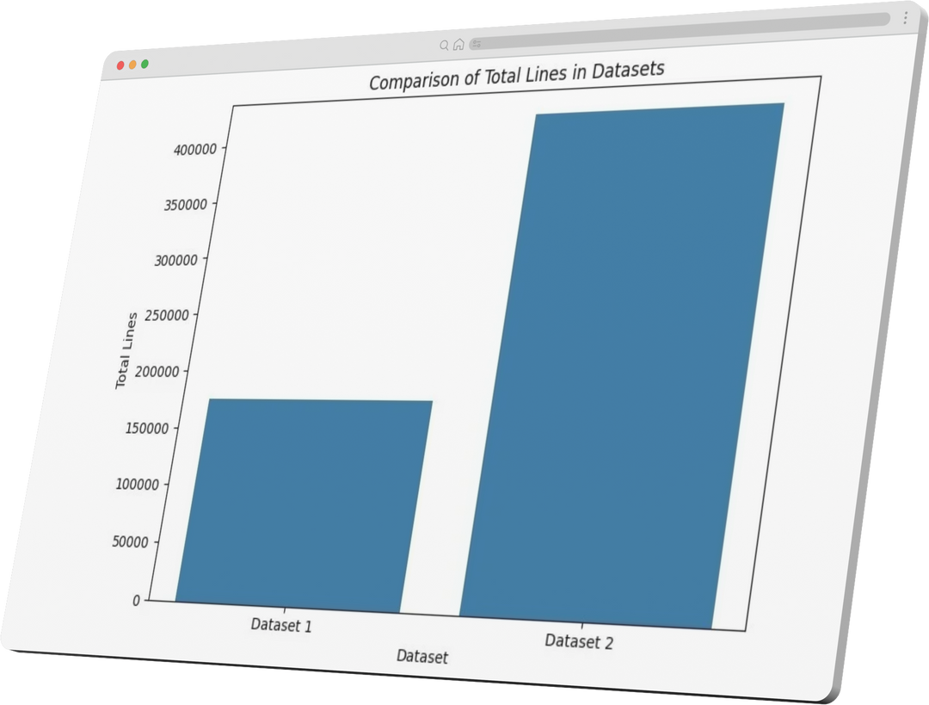
Data Overview
 | Dataset 1 | Dataset 2
Total rows | 175,514 | 417,319
Total columns | 6 | 6
Memory usage | 8.0 MB | 19.1MB
Missing values | 384 | None
Negative values | 482 | 1

Slide 7





Data Preprocessing Steps
1
2
3
4
Date Standardization
Column Management
Handling Missing Values
Handling Negative Values
Removed unnecessary time information from "Date" column.
Converted "Date" to a standardized datetime format for time-series analysis.
Removed redundant original "Date" column.
Reordered columns to place "DATE" (datetime format) as the first column for clarity.
Analyzed missing values in Dataset 1 (affected rows, columns, nature).
Removed rows with missing values in key columns ("ProductId", "Quantity", "Amount") to ensure data integrity for analysis.
Identified and addressed presence of extreme negative values in sales data (especially Dataset 1).
Explained the rationale for removing all negative values from both datasets (data integrity, statistical distortion, forecasting accuracy, business logic, standardization, simplicity).
Highlighted the impact (number of rows removed) and justification for this approach.

Slide 8

Model Development - Model Selection
An ensemble of five models: Prophet, XGBoost, Gradient Boosting,RandomForest and LightGBM.
Prophet is a statistical forecasting model suitable for time series data
XGBoost and Gradient Boosting are machine learning algorithms known for their predictive power.
The ensemble approach combines the strengths of these models to enhance accuracy and robustness.
Accuracy Variance: The model's accuracy can vary across runs due to the stochastic nature of optimization and training. For instance, Dataset 1 might yield 87% accuracy in one run and 89% in another, but the accuracy is generally consistent and does not fluctuate significantly
Contributing Factors: Variance is influenced by randomized hyperparameter optimization, model initialization, train-test splits, data preprocessing, and the ensemble method.
Benefits
Improved accuracy by combining the strengths of different models.
Reduced overfitting by mitigating the reliance on a single model.
Increased robustness to variations in data and trends.
Ensemble Method
The ensemble_predictions function selects the prediction closest to the actual value for each time point, leveraging the best model at each time step.

Slide 9

Model Development - Model Training
Data Preprocessing
Ensemble
Filtered negative sales amounts.
Converted the date to datetime format.
Aggregated sales data by month.
Handled outliers using Interquartile Range (IQR).
Merged with economic data and filled missing values.
Combined predictions from the five models using the ensemble_predictions function.
Model Training
Feature Engineering
Trained Prophet, XGBoost, and Gradient Boosting models using the preprocessed data.
Incorporated economic indicators as regressors.
Performed hyperparameter tuning using Optuna.
Created additional features (temporal, cyclical, lag, rolling statistics).

Slide 10

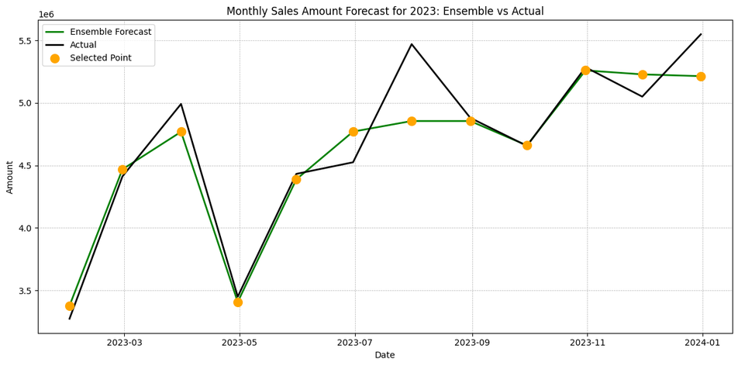
Model Development - Model Evaluation
Metrics
Accuracy Analysis
Mean Absolute Percentage Error (MAPE): Measures prediction accuracy as a percentage.
Root Mean Square Error (RMSE): Provides an absolute measure of the prediction error.
Presented the overall accuracy and error metrics for both datasets.
Discussed the model's performance in terms of prediction accuracy and error levels.
Model Robustness
Error Analysis
Analyzed specific predictions with significant errors to identify potential areas for improvement.
Considered factors like seasonality, economic events, or data anomalies that might influence prediction accuracy.

Slide 11
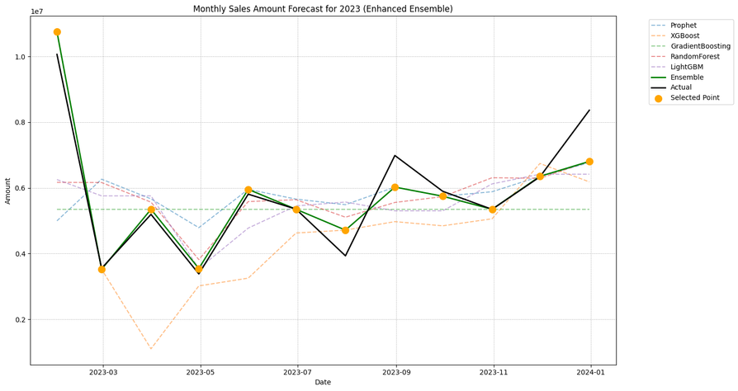
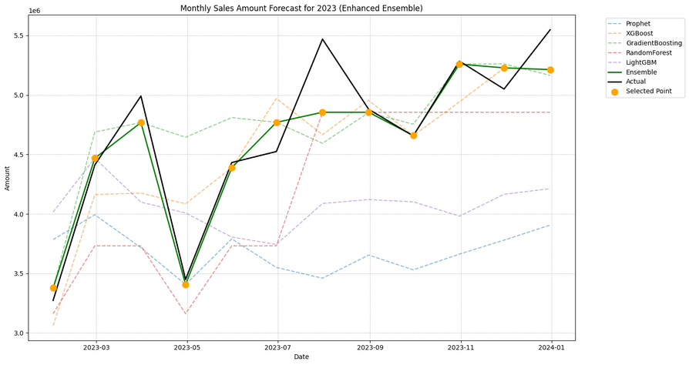
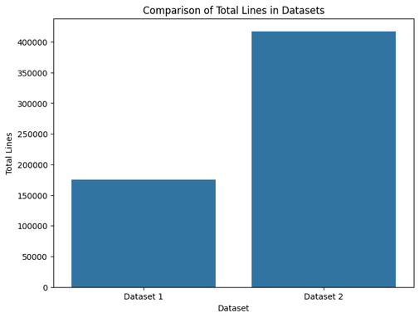
Dataset 1
Dataset 2
Final Outcome
Accuracy: 93.90% (derived from MAPE)
MAPE: 0.0610
RMSE: 614,523.62
Accuracy: 96.79% (derived from MAPE)
MAPE: 0.0321
RMSE: 233,015.36
Key findings
The model demonstrated scalability and adaptability to different data sizes.
Larger datasets led to improved accuracy, aligning with machine learning principles.
The ensemble approach and economic indicators contributed to the model's robustness.
The model maintained consistent performance across datasets, avoiding overfitting.

Slide 12



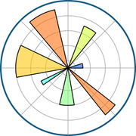







Tech Stack Used
Programming Language
Libraries & Frameworks
Pandas
Numpy
Scipy
Prophet
cmdstanpy
xgboost
scikit-learn
gradient boosting
lightgbm
randomforest
Optuna
matplotlib
seaborn
Time Series Forecasting
Machine Learning
Optimization
Visualization
Data Manipulation & Analysis
Development Environment
Anaconda
Jupyter Notebook
VS Code
Google Colab

Slide 13




Potential Enhancements
Incorporate additional domain-specific variables.
Explore feature selection techniques.
Additional Features or Data
Integrate external market data.
Consider other relevant data sources.
Scalability Considerations
Deploy on cloud-based infrastructure.
Optimize code for efficiency.

Slide 14



Meet our Team!
AQIL
BADAR
ALIF

